Slide 1
Chapter 7
Financial Documents
Income Statement
Balance Sheet

Slide 2
Income Statement
A financial form that includes all of the money we have made ( revenue) and shows all of the money that we have spent.
It is also a form that is easier for people to understand versus the mess of a worksheet. In other words, it is easier for the regular person to read and understand.
In bigger businesses it is used to show potential stockholders how well the company is doing…

Slide 3
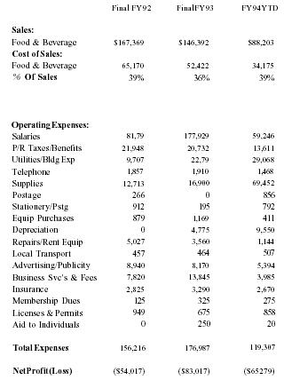
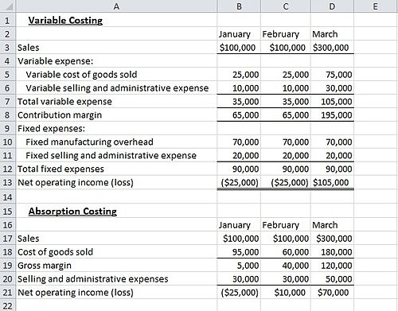
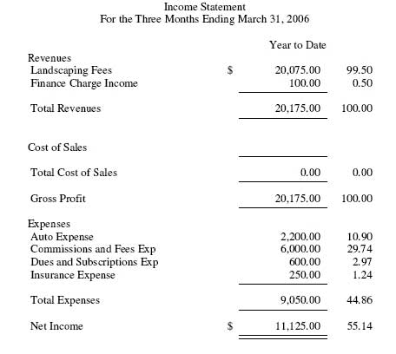
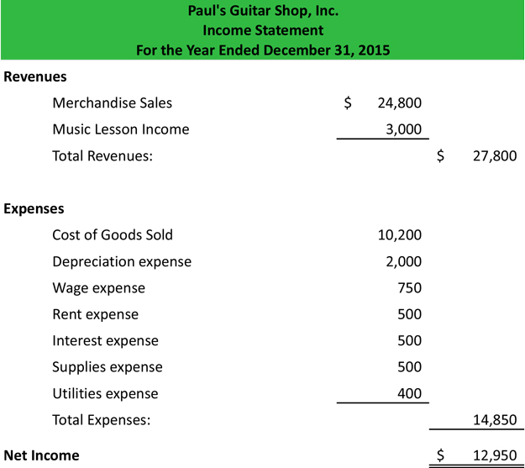
Income statements come in all shapes and sizes…..

Slide 4
So How do we create this statement???
 | Trial Balance |  | Adjustments |  | Income Statement |  | Balance Sheet
Account Title
Cash | 2609 |  |  |  |  |  | 2609
Petty Cash | 300 |  |  |  |  |  | 300
Accts. Rec - Robert Perpich | 581 |  |  |  |  |  | 581
Supplies | 895 |  |  | 445 |  |  | 450
Prepaid Insurance | 1200 |  |  | 200 |  |  | 1000
Accts Pay- Ely Supplies |  | 450 |  |  |  |  |  | 450
Jens Miller-Smith, Capital |  | 4550 |  |  |  |  |  | 4550
Jens Miller-Smith, Drawing | 300 |  |  |  |  |  | 300
Income Summary
Sales |  | 3100 |  |  |  | 3100
Advertising Expense | 425 |  |  |  | 425
Insurance Expense |  |  | 200 |  | 200
Miscellaneous Expense | 250 |  |  |  | 250
Rent Expense | 1100 |  |  |  | 1100
Supplies Expense |  |  | 445 |  | 445
Utilities Expense | 440 |  |  |  | 440
 | 8100 | 8100 | 645 | 645 | 2860 | 3100 | 5240 | 5000
Net Income or Loss |  |  |  |  | 240 |  |  | 240
 |  |  |  |  | 3100 | 3100 | 5240 | 5240

Slide 5
 |  |  | % of Sales
 | Trial Balance |  | Adjustments |  | Income Statement |  | Balance Sheet
Account Title
Cash | 2609 |  |  |  |  |  | 2609
Petty Cash | 300 |  |  |  |  |  | 300
Accts. Rec - Robert Perpich | 581 |  |  |  |  |  | 581
Supplies | 895 |  |  | 445 |  |  | 450
Prepaid Insurance | 1200 |  |  | 200 |  |  | 1000
Accts Pay- Ely Supplies |  | 450 |  |  |  |  |  | 450
Jens Miller-Smith, Capital |  | 4550 |  |  |  |  |  | 4550
Jens Miller-Smith, Drawing | 300 |  |  |  |  |  | 300
Income Summary
Sales |  | 3100 |  |  |  | 3100
Advertising Expense | 425 |  |  |  | 425
Insurance Expense |  |  | 200 |  | 200
Miscellaneous Expense | 250 |  |  |  | 250
Rent Expense | 1100 |  |  |  | 1100
Supplies Expense |  |  | 445 |  | 445
Utilities Expense | 440 |  |  |  | 440
 | 8100 | 8100 | 645 | 645 | 2860 | 3100 | 5240 | 5000
Net Income or Loss |  |  |  |  | 240 |  |  | 240
 |  |  |  |  | 3100 | 3100 | 5240 | 5240
Name of Company
So How do we create this statement???
Income Statement
 | 3100
425
200
250
1100
445
440
Income Statement
Account Title
Cash
Petty Cash
Accts. Rec - Robert Perpich
Supplies
Prepaid Insurance
Accts Pay- Ely Supplies
Jens Miller-Smith, Capital
Jens Miller-Smith, Drawing
Income Summary
Sales
Advertising Expense
Insurance Expense
Miscellaneous Expense
Rent Expense
Supplies Expense
Utilities Expense
Net Income or Loss
For month ending Dec 31, 20xx
How do I know this is right??
Revenue
Sales
3100
100%
Expenses
Advert Expense
425
Insurance Exp
200
Misc. Expense
250
Rent Expense
1100
Supplies Expense
445
Utilities Expense
440
Total Expense
2860
92.3%
Net Income
240
7.7%%

Slide 6
Balance Sheet
Again another Financial form to make it easier for people to understand what Assets we have, Bills we pay, and how much the owner’s worth is in the business

Slide 7
So How do we create this statement???
 | Trial Balance |  | Adjustments |  | Income Statement |  | Balance Sheet
Account Title
Cash | 2609 |  |  |  |  |  | 2609
Petty Cash | 300 |  |  |  |  |  | 300
Accts. Rec - Robert Perpich | 581 |  |  |  |  |  | 581
Supplies | 895 |  |  | 445 |  |  | 450
Prepaid Insurance | 1200 |  |  | 200 |  |  | 1000
Accts Pay- Ely Supplies |  | 450 |  |  |  |  |  | 450
Jens Miller-Smith, Capital |  | 4550 |  |  |  |  |  | 4550
Jens Miller-Smith, Drawing | 300 |  |  |  |  |  | 300
Income Summary
Sales |  | 3100 |  |  |  | 3100
Advertising Expense | 425 |  |  |  | 425
Insurance Expense |  |  | 200 |  | 200
Miscellaneous Expense | 250 |  |  |  | 250
Rent Expense | 1100 |  |  |  | 1100
Supplies Expense |  |  | 445 |  | 445
Utilities Expense | 440 |  |  |  | 440
 | 8100 | 8100 | 645 | 645 | 2860 | 3100 | 5240 | 5000
Net Income or Loss |  |  |  |  | 240 |  |  | 240
 |  |  |  |  | 3100 | 3100 | 5240 | 5240

Slide 8
Beginning Capital Balance 5050
+ Net Income or – Net Loss 240
Drawing Account 300
New Capital Balance 4990
Cash | 2609 |  | Accts Pay – Ely Supply | 500
Petty Cash | 350 |  | Total Liabilities
Accts Rec. Robert P | 581 |  | Owner’s Equity
Supplies | 450 |  | Jens Miller Capital | 4990
Prepaid Insurance | 1500
Total Assets | 5490 |  | Total Liability and Owner’s Equity | 5490
Name of Company
Balance Sheet
2609
350
581
450
1500
 | 500
 | 5050
300
5790 | 5550
 | 240
5790 | 5790
Account Title
Cash
Petty Cash
Accts. Rec - Robert Perpich
Supplies
Prepaid Insurance
Accts Pay- Ely Supplies
Jens Miller-Smith, Capital
Jens Miller-Smith, Drawing
Income Summary
Sales
Advertising Expense
Insurance Expense
Miscellaneous Expense
Rent Expense
Supplies Expense
Utilities Expense
Name of the sheet
Date
Assets
Liabilities

